Slide 1
Index
CSCI Framework Training.
(A) Common Utility.
(B) Authorization & Security.
(C) ICSC Framework.
(D) Report Development.
(E) Program Development Workshop.

Slide 2
(A) Common Utility.
Quality
Control
Sales
Production
Financial Accounting
Procurement
Material
Equipment
ERP Domain
Systems
Security
Service
API
Resource
Access
API
Common
Utility
API
Data Access
Management
API
Report
Service
API
Data
Exchange
API
ERP Module
Operation
Platform
IPMS – Information Process Management System
J2EE compatible Application Server
Server
Platform
Operation System

Slide 3
(A) Common Utility.
Class | Used For | Class | Used For
dejc300 | Common Class | de318 | Trace Logs
dejc301 | JDBC Connection | de322 | Simple Table Form
dejc308 | Get Current Date | de323 | Simple table Data
dejc309 | Check date and Get date in another format | de328 | Upload files.
dejc310 | String Utility | de329 | Get Upload files.
dejc314 | Compute time | de332 | Get AP Properties Config
dejc315 | Compute difference between two dates

Slide 4
(B) Authorization & Security.
Common Area
When user login, dsjcCom object is created.
dsCom.AppId – Gives the appId
dsCom.linkType – Gives 1 or 0 (1 for jdbc and 0 for datasource)
dsCom.homeUrl – Gives HomeUrl
Information of User who login
dsCom.user.* – where in * => ID, chineseName, position, positionName, department, departmentName
Information of Connect to DB
dsCom.db.url : if dsCom.linkType == 1, dejc301 will reference it(jdbc:db2:idbicsc)
dsCom.db.dataSource : when dsCom.linkType ==0 =>(jdbc/DataSource)

Slide 5
(C) ICSC Framework.
Basic Flow of the MVC in Struts.
Model :- The model contains the business logic and interact with the persistence storage to store, retrieve and manipulate data.
View :- The view is responsible for displaying the results back to the user. In Struts the view layer is implemented using JSP.
Controller :- The Controller handles all the request from the user and selects the appropriate view to return. In Struts the controller’s job is done by the Action Servlet.

Slide 6
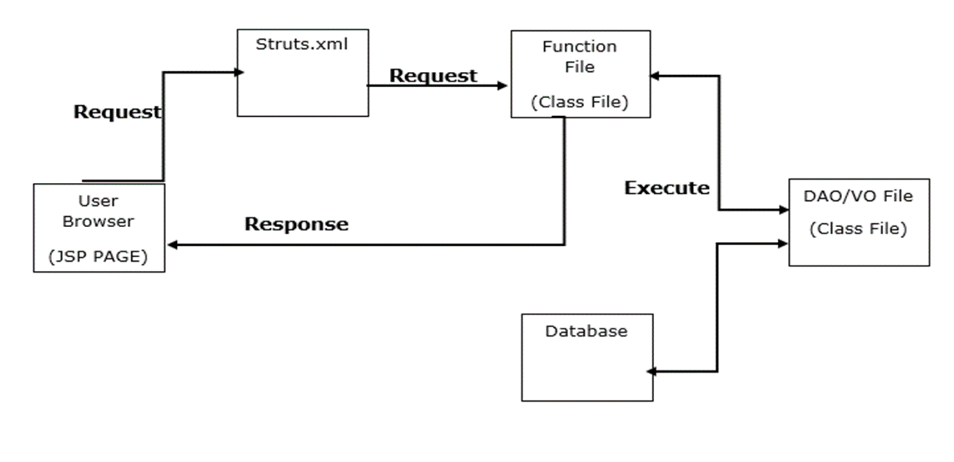
(C) ICSC Framework.

Slide 7
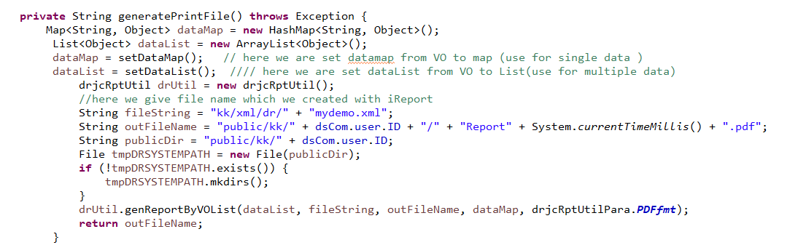
(D) Report Development- PDF Format.
In Pdf report Development, we create Report Structure using iReport Software
iReport generate xml file
In the ERP, IPMS provides DR API to execute jasperreport engine for generating PDF.

Slide 8
(D) Report Development. – Excel Format.
There are two types of reports.
1.SimpleList report.
2.Merge report.
Difference Between SimpleList Report and Merge Report
 | SimpleList Report |  | Merge Report
1. | mergeSimpleList method is used | 1. | mergeForm method is used
2 | All data are shown without pagination. | 2 | All data are shown with pagination feature.

Slide 10
Thank You

